Slide 1
COMP3511
Project Assignment 2 Introduction

Slide 2
Introduction
The Linux kernel implements a completely fair scheduler (CFS)
In this project, we need to implement a simplified version of CFS
Please note that the details of CFS are not covered in the lecture notes
In this lab, we are going to cover the detailed requirements of implementing a simplified CFS

Slide 3
How to run the program?
Here is a sample usage:
$> ./cfs < input.txt > output.txt
$> represents the shell prompt
< means input redirection
> means output redirection
Thus, you can easily replace input.txt with different test cases and then use the diff command to compare with the sample output files

Slide 4
Skeleton code
The input parsing is given in the skeleton code
You can add new constants, variables, and helper functions
Necessary header files are included
You should not add extra header files
Assumptions
There are at most 10 different processes
There are at most 300 steps in the Gantt chart
Some constants and helper functions are provided
Please read the skeleton code carefully

Slide 5
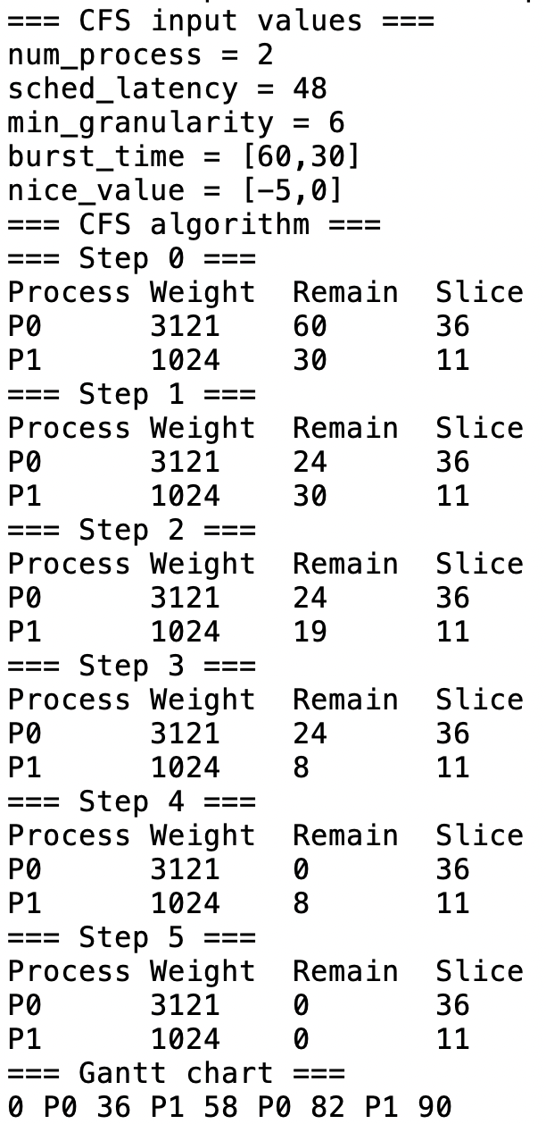
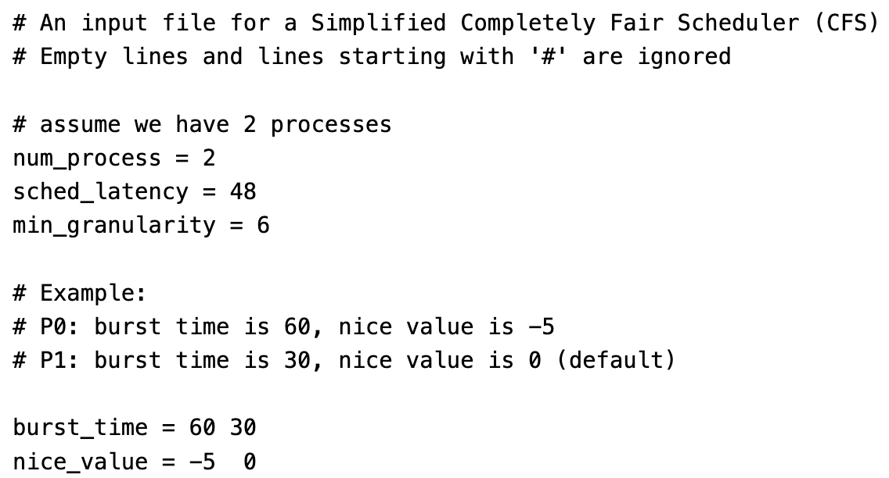
Sample input and output
Sample Output
Sample Input

Slide 6
Input format
The input parsing is given in the skeleton code
Empty lines and lines starting with # are ignored
Format of constant: name = <value>
Format of vector: name = <values of the vector>
Sample Input

Slide 7
Output format
Sample Output
1st region
The output consists of 3 regions:
Display the parsed values
Display the intermediate steps
Display the final Gantt chart
The final Gantt chart string is equivalent to:
2nd region
P0 | P1 | P0 | P1
0
36
58
82
90
3rd region

Slide 8
Completely Fair Scheduler (CFS) Overview
CFS uses a simple counting-based technique called virtual runtime (vruntime)
Each process has its vruntime, with a default value 0
As each process runs, it accumulates vruntime
When a scheduling decision occurs, CFS will pick an unfinished process with the smallest vruntime to run next

Slide 9
Pseudocode of CFS scheduler
Loop until all processes are finished
Pick the next process based on vruntime
Calculate the new vruntime of that process, and remove that process from the scheduling algorithm if that process is finished
Update the Gantt chart
Display the information in the current step

Slide 10
vruntime in the intermediate steps
vruntime is a floating-point value
It may cause some troubles in the grading if vruntime is shown due to some precision errors
In the skeleton code:
DISPLAY_VRUNTIME is used to control whether to display the vruntime
You can enable the display during debugging
Remember to disable the display before your submission
vruntime is not shown in the sample executable
In the step-by-step demonstrations in the next few slides, vruntime is shown

Slide 11
CFS Configuration Strategies
Scheduler Latency (sched_latency)
Minimum Granularity (min_granularity)
Controlling the process priority

Slide 12
Scheduler Latency (sched_latency)
CFS uses sched_latency, with a typical value like 48ms, to determine how long one process should run before considering a switch
Example:
If we have 2 processes, without considering the process priority, the per-process time slice is equal to: 48/2 = 24ms
We will discuss how to calculate the per-process time slice when the process priority is considered

Slide 13
Minimum Granularity (min_granularity)
If the per-process time slice is too short
Performance will be degraded due to the overhead of context switch
CFS adds min_granularity, with a typical value like 6ms, to control the minimum per-process time slice
Example:
If there are 12 processes and sched_latency is 48ms
Per-process time slice is 48/12 = 4ms, which is smaller than min_granularity (6ms)
The per-process time slice will be set to 6ms

Slide 14
Controlling the process priority
The classic UNIX (i.e., the predecessor of Linux) mechanism known as the nice level is adopted.
The nice parameter can be set anywhere from -20 to 19 for a process, with a default nice value 0.
Positive nice values imply lower priority and negative values imply higher priority.

Slide 15
Mapping Nice Values to CFS Weights
CFS maps the nice values (defined in Unix/Linux) to the CFS weights:
DEFAULT_WEIGHT refers to nice value 0
The following mapping is implemented in the skeleton code
static const int DEFAULT_WEIGHT = 1024;
static const int NICE_TO_WEIGHT[40] = {
88761, 71755, 56483, 46273, 36291, // nice: -20 to -16
29154, 23254, 18705, 14949, 11916, // nice: -15 to -11
9548, 7620, 6100, 4904, 3906, // nice: -10 to -6
3121, 2501, 1991, 1586, 1277, // nice: -5 to -1
1024, 820, 655, 526, 423, // nice: 0 to 4
335, 272, 215, 172, 137, // nice: 5 to 9
110, 87, 70, 56, 45, // nice: 10 to 14
36, 29, 23, 18, 15, // nice: 15 to 19
};

Slide 16
Calculating the per-process time slice
These weights allow us to compute the effective time slice of each process, but now accounting for their priority differences
Scale up/down to an integer time slice (i.e., higher/lower weight => larger/smaller time slice)
Some concrete examples will be given in the next few slides
Here is the exact formula:
(int)((double) weight * sched_latency / sum_of_weight);

Slide 17
Example: Calculating the per-process time slice
Suppose we have the following 2 processes
The time slices are calculated at the last column of the following table:
Note 1: sum_of_weight = 3121+1024 = 4145
Note 2: both time slices are larger than min_granularity (6ms)
Process | Burst Time | Nice Value | Weight (from table) | Time slice (calculated)
P0 | 60 | -5 | 3121 | 36
P1 | 30 | 0 | 1024 | 11
Why scaling the time slices? Reason: If all time slices are larger than min_granularity, the sum of all time slices should be roughly (may not exactly due to precision issues) equal to sched_latency

Slide 18
Updating vruntime
We need to compute and update the vruntime
The following formula is used to update the vruntime
vruntime + (double) DEFAULT_WEIGHT / weight * runtime;

Slide 19
Simplified CFS: How to pick the next process to run?
In each step, we need to pick an unfinished process with the smallest vruntime to run next
What happen if we have more than one choices?
It usually happens at the beginning because all vruntime are 0.0
If there are more than one processes having the same smallest vruntime, pick the process with the smallest process ID
For example, if both P0 and P1 have the smallest vruntime, we pick P0 because it has a smaller process ID

Slide 20
Simplified CFS: Any special data structure?
In the Linux kernel CFS implementation, a data structure named as red-black tree should be used
Red-black tree is one of many types of balanced trees, which gives a logarithmic running time for each query
In this project, you DO NOT need to implement the red-black tree data structure
In each step, you only need to search the whole list of process to find the process with the smallest vruntime, with the worst-case linear running time.

Slide 21
Simplified CFS: Debugging tips
By default, the vruntime for each step is not displayed for the grading purposes
During development, you can enable the display of vruntime
DISPLAY_VRUNTIME
You can alter this special constant near the top of the skeleton code

Slide 22
A Step-by-Step CFS Example
For example, suppose we have the following 2 processes.
Please note that 2 decimal places are shown for the current vruntime:
Step 0:
Question: Which process will be picked next?
Process | Weight | Remain Time | Time slice | vruntime
P0 | 3121 | 60 | 36 | 0.00
P1 | 1024 | 30 | 11 | 0.00

Slide 23
Step 1
P0 is picked to run
because it has the smallest vruntime (indeed, both P0 and P1 have the smallest vruntime, but P0 is the process having the smallest process ID).
P0 runs for 36ms
The table is updated as follows:
Question: Which process will be picked next?
Process | Weight | Remain Time | Time slice | vruntime
P0 | 3121 | 24 | 36 | 11.81
P1 | 1024 | 30 | 11 | 0.00

Slide 24
Step 2
P1 is picked to run because it has the smallest vruntime
P1 runs for 11ms
The table is updated as follows:
Question: Which process will be picked next?
Process | Weight | Remain Time | Time slice | vruntime
P0 | 3121 | 24 | 36 | 11.81
P1 | 1024 | 19 | 11 | 11.00

Slide 25
Step 3
P1 is picked to run because it has the smallest vruntime
P1 runs for 11ms
The table is updated as follows:
Question: Which process will be picked next?
Process | Weight | Remain Time | Time slice | vruntime
P0 | 3121 | 24 | 36 | 11.81
P1 | 1024 | 8 | 11 | 22.00

Slide 26
Step 4
P0 is picked to run because it has the smallest vruntime
P0 runs for 24ms
Note: The remaining time is smaller than the time slice
The table is updated as follows:
Question: Which process will be picked next?
Process | Weight | Remain Time | Time slice | vruntime
P0 | 3121 | 0 | 36 | 19.69
P1 | 1024 | 8 | 11 | 22.00

Slide 27
Step 5
P1 is picked to run
Note: Even P0 has the smallest vruntime, but it is already finished, thus P1 is a process having the smallest vruntime in the current process list
P1 runs for 8ms
Note: The remaining time is smaller than the time slice
The table is updated as follows:
Question: Which process will be picked next?
Process | Weight | Remain Time | Time slice | vruntime
P0 | 3121 | 0 | 36 | 19.69
P1 | 1024 | 0 | 11 | 30.00

Slide 28
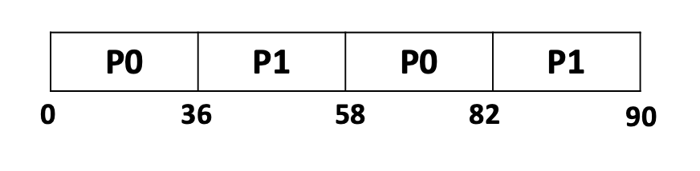
The final Gantt Chart
No processes can be picked next because all processes are finished
Remain Time = 0 for all processes
The final Gantt chart is:
Running time:
36ms
22ms
24ms
8ms

Slide 29
Sample test cases
Test cases are provided
The grader TA will probably write a grading script to mark the test cases
Please use the Linux diff command to compare your output with the sample output
$> diff --side-by-side your-outX.txt sample-outX.txt
An extra option --suppress-common-lines can be added if you are not interested in the common lines. If both text files are the same, adding --suppress-common-lines will print nothing on the screen.

Slide 30
Summary
Think carefully before you type ANY line of code
Good C programmers never do trial-and-error
A program that can compile does not mean that it can execute correctly
Check carefully to avoid runtime errors (i.e., Segmentation fault)
Read carefully the provided base code
Compare your output files with the sample output files using the Linux diff command

Slide 31

References
This project and teaching slides are modified based on the discussion of CFS in
Chapter 9 - Scheduling: Proportional Share of Operating Systems: Three Easy Pieces
Starting from page 7 of Chapter 9
This book is one of the reference books in this course
Free book chapters are available: https://pages.cs.wisc.edu/~remzi/OSTEP/#book-chapters

Slide 32
Live Demo
The skeleton code
The sample Linux executable program

